Slide 1
ENGT 3510
Chapter 4
Continuous Random Variables & Probability Distributions

Slide 2
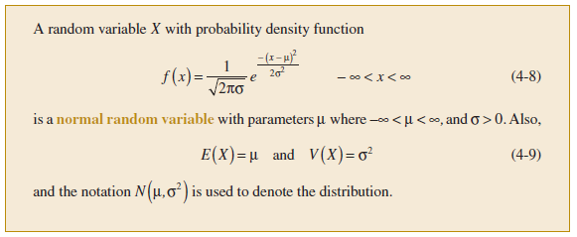
Normal Distribution
The most widely used model for a continuous measurement is a normal random variable.
Many populations have distributions that can be fit very closely by an appropriate normal (or Gaussian, bell) curve.
Examples: height, weight, and other physical characteristics, scores on various tests, etc.
A normal distribution is also referred to as a Gaussian distribution

Slide 3
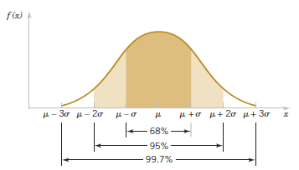

Normal Distribution
Properties
The mean, median and mode are equal.
Bell-shaped curve
Symmetric about the mean
The normal curve approaches, but never touches, the x-axis as it extends farther and farther away from the mean.
Total area under the curve equal to 1.

Slide 4
Normal Distribution
How can I test that a dataset is normally distributed or not?

Slide 5
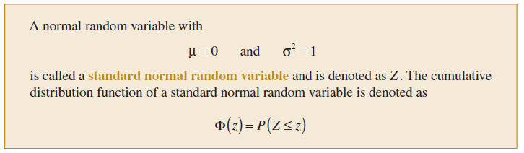
Normal Distribution
Appendix Table III provides cumulative probabilities for a standard normal random variable.

Slide 6
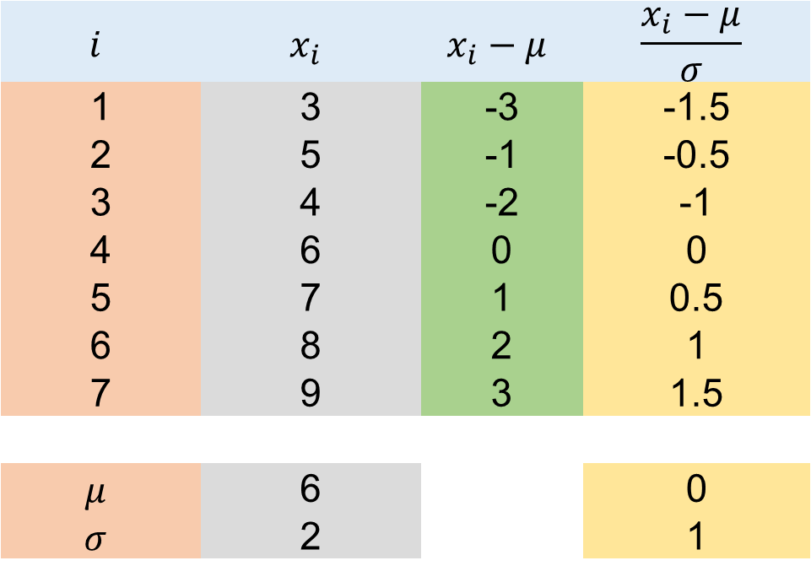
Standard Normal Data
$$i$$ | $$x_{i}$$ | $$x_{i}−μ$$ | $$\frac{x_{i}−μ}{σ}$$
1 | 3 | -3 | -1.5
2 | 5 | -1 | -0.5
3 | 4 | -2 | -1
4 | 6 | 0 | 0
5 | 7 | 1 | 0.5
6 | 8 | 2 | 1
7 | 9 | 3 | 1.5
$$μ$$ | 6 |  | 0
$$σ$$ | 2 |  | 1

Slide 7
Standard Normal Data
$$i$$ | $$x_{i}$$ | $$x_{i}−μ$$ | $$\frac{x_{i}−μ}{σ}$$
1 | 3 | -3 | -1.5
2 | 5 | -1 | -0.5
3 | 4 | -2 | -1
4 | 6 | 0 | 0
5 | 7 | 1 | 0.5
6 | 8 | 2 | 1
7 | 9 | 3 | 1.5
$$μ$$ | 6 |  | 0
$$σ$$ | 2 |  | 1

Slide 8
Standard Normal Data
$$i$$ | $$x_{i}$$ | $$x_{i}−μ$$ | $$\frac{x_{i}−μ}{σ}$$
1 | 3 | -3 | -1.5
2 | 5 | -1 | -0.5
3 | 4 | -2 | -1
4 | 6 | 0 | 0
5 | 7 | 1 | 0.5
6 | 8 | 2 | 1
7 | 9 | 3 | 1.5
$$μ$$ | 6 |  | 0
$$σ$$ | 2 |  | 1

Slide 9
Standard Normal Data
$$i$$ | $$x_{i}$$ | $$x_{i}−μ$$ | $$\frac{x_{i}−μ}{σ}$$
1 | 3 | -3 | -1.5
2 | 5 | -1 | -0.5
3 | 4 | -2 | -1
4 | 6 | 0 | 0
5 | 7 | 1 | 0.5
6 | 8 | 2 | 1
7 | 9 | 3 | 1.5
$$μ$$ | 6 |  | 0
$$σ$$ | 2 |  | 1

Slide 10

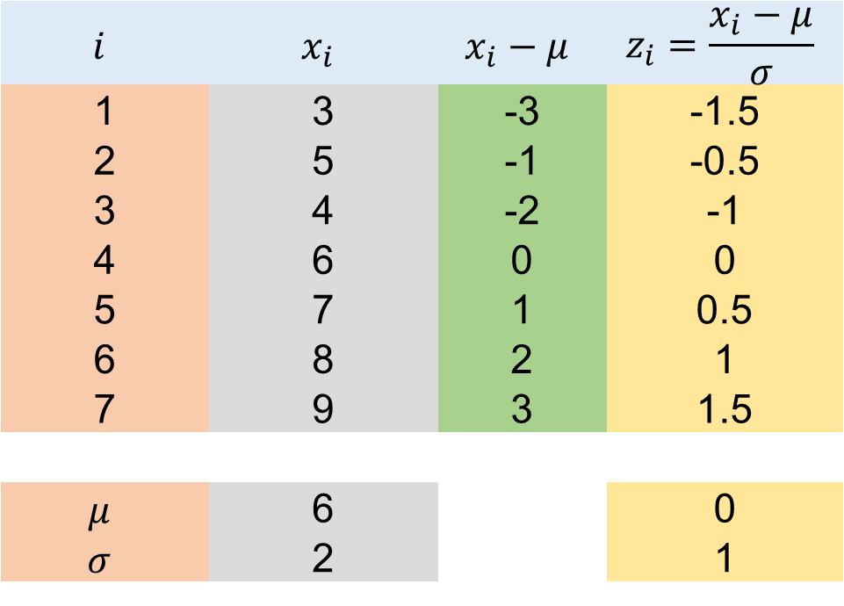
Standard Normal Data
$$i$$ | $$x_{i}$$ | $$x_{i}−μ$$ | $$z_{i}=\frac{x_{i}−μ}{σ}$$
1 | 3 | -3 | -1.5
2 | 5 | -1 | -0.5
3 | 4 | -2 | -1
4 | 6 | 0 | 0
5 | 7 | 1 | 0.5
6 | 8 | 2 | 1
7 | 9 | 3 | 1.5
$$μ$$ | 6 |  | 0
$$σ$$ | 2 |  | 1
$$z_{i}=\frac{x_{i}−μ}{σ}$$
$$⇒x_{i}−μ=z_{i}σ$$
$$⇒x_{i}=μ+z_{i}σ$$

Slide 11
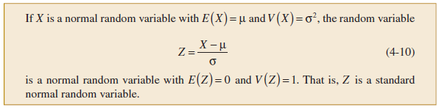
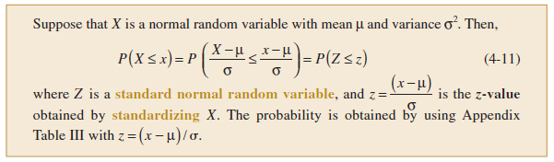
Normal Distribution
Standard Normal Distribution

Slide 12

Normal Distribution
Determine the following probabilities for the standard normal random variable Z:
$P(Z<1.32)$
$P(Z>− 2.15)$

Slide 13

Normal Approximation to Binomial Distribution
The normal distribution as an approximation to a random variable with a large number of trials.
The normal distribution can be used to approximate binomial probabilities for cases in which $n$ is large.
For extremely large value of $n$, it is difficult to calculate probabilities by using the binomial distribution.

Slide 14
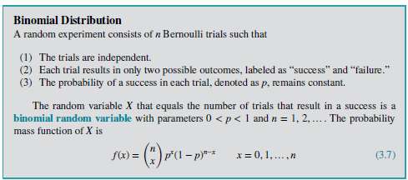

Binomial Distribution (Recap)

Slide 15
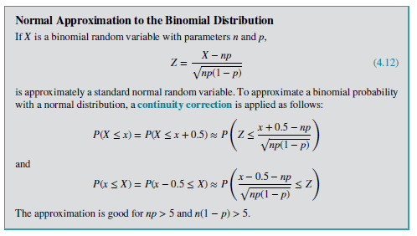
Normal Approximation to Binomial Distribution

Slide 16
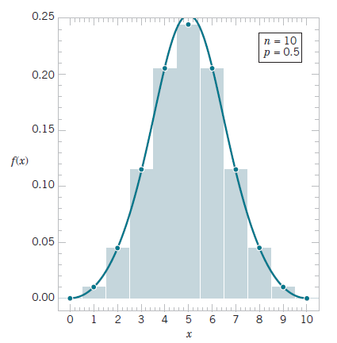

Normal Approximation to Binomial Distribution
$P(3 ≤ X ≤ 7)$ is better approximated by the area under the normal curve from 2.5 to 7.5.
Consequently, a modified interval is used to better compensate for the difference between the continuous normal distribution and the discrete binomial distribution. This modification is called a continuity correction.

Slide 17

Normal Approximation to Binomial Distribution
Example: Assume that in a digital communication channel, the number of bits received in error can be modeled by a binomial random variable, and assume that the probability that a bit is received in error is $1×{10}^{−5}$. If 16 million bits are transmitted, what is the probability that 150 or fewer errors occur?
Solution
$$n=16 million=16×{10}^{6}, p=1×{10}^{−5}$$
$$P\left(X≤150\right)=P\left(X≤150+0.5\right)=P\left(X≤150.5\right)$$
$$=P\left(z≤\frac{X−np}{\sqrt{np\left(1−p\right)}}\right)=P\left(z≤\frac{150−16×{10}^{6}×{10}^{−5}}{\sqrt{16×{10}^{6}×{10}^{−5}\left(1−1×106−5\right)}}\right)$$
$$=P\left(z≤−0.75\right)=0.227$$

Slide 18
Normal Approximation to Binomial Distribution
Exercise: The manufacturing of semiconductor chips produces 2% defective chips. Assume that the chips are independent and that a lot contains 1000 chips. Approximate the following probabilities:
More than 25 chips are defective.
Between 20 and 30 chips are defective.

Slide 19

Weibull Distribution
Like the normal distribution, the Weibull distribution is unimodal and describes probabilities associated with continuous data.
However, unlike the normal distribution, it can also model skewed data.
A typical Weibull distribution has two parameters:
Shape $(β)$
Scale $(δ)$

Slide 20
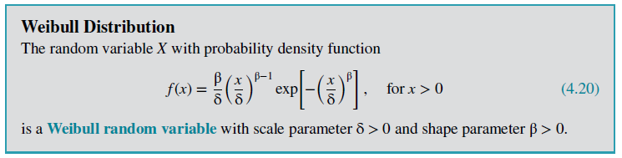
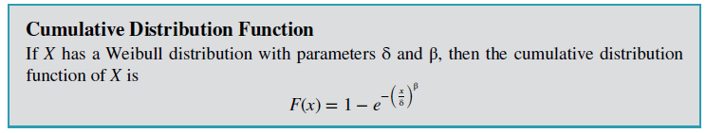
Weibull Distribution

Slide 21
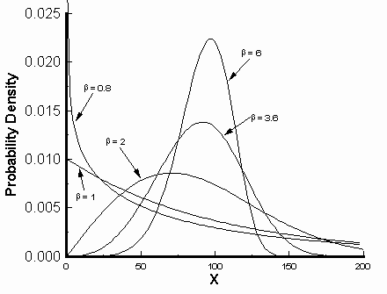


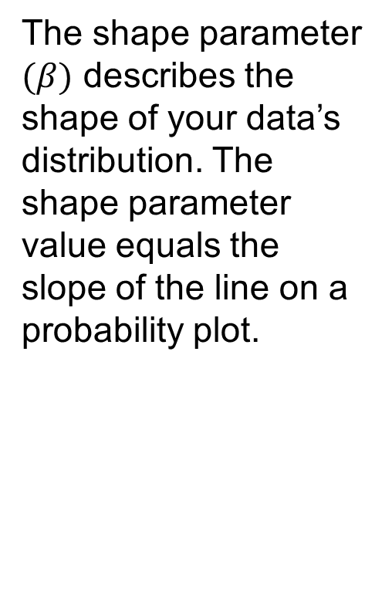



Weibull Distribution
The shape parameter $(β)$ describes the shape of your data’s distribution. The shape parameter value equals the slope of the line on a probability plot.
$β=$6
$β=$0.8
$β=$3.6
$β=$2
$β=$1
The shape value between 3 and 4, the Weibull distribution becomes symmetric and bell-shaped, like the normal curve

Slide 22

Weibull Distribution
The value for the shape parameter (γ) determines the
failure rates:
If $β<1$, then the failure rate decreases with time (i.e. the process has a large number of infantile or early-life failures and fewer failures as time passes).
For $β=1$: the failure rate is constant, which means it’s indicative of useful life or random failures.
If $β>1$: the failure rate increases with time (i.e. the distribution models wear-out failures, which tend to happen after some time has passed).

Slide 23
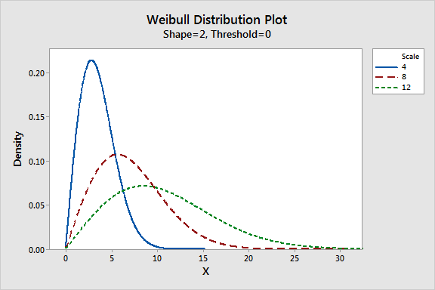
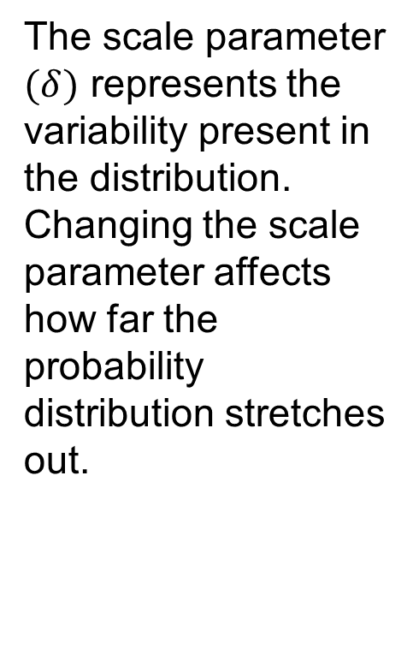

Weibull Distribution
The scale parameter $(δ)$ represents the variability present in the distribution. Changing the scale parameter affects how far the probability distribution stretches out.
Weibull Distribution
$$β=2$$

Slide 24

Weibull Distribution
The time to failure (in hours) of a bearing in a mechanical
shaft is satisfactorily modeled as a Weibull random variable
with $β=\frac{1}{2}$and $δ=5000$ hours. Determine the probability that a bearing lasts at least 6000 hours.
Solution
$$P\left(X≥6000\right)=1−P\left(X<6000\right)$$
$$=1−\left(1−e^{−{\left(\frac{x}{δ}\right)}^{β}}\right)$$
$$=e^{−{\left(\frac{x}{δ}\right)}^{β}}$$
$$=e^{−{\left(\frac{6000}{5000}\right)}^{1/2}}=0.237$$

Slide 25

Weibull Distribution
Exercise: Assume that the life of a roller bearing follows a Weibull distribution with parameters
$β=2$and $δ=10,000$hours. Determine the probability that a bearing lasts at most 8000 hours.

Slide 26

Lognormal Distribution
A random variable is lognormally distributed if its logarithm is normally distributed.
Skewed distributions with low mean values, large variance, and all-positive values often fit this type of distribution.
Values must be positive as $log⁡(x)$ exists only for positive values of $x$.

Slide 27
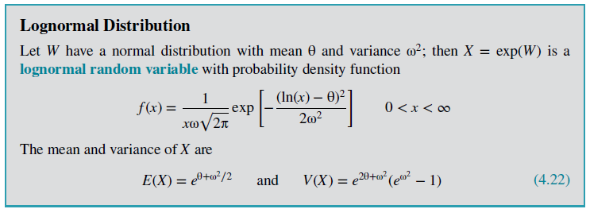

Lognormal Distribution
For instance,
$$X=\exp\left(W\right)$$
$X$ is exponent of random variable $W$.
When W has a normal distribution, the distribution of $X$ is called a lognormal distribution.

Slide 28

Lognormal Distribution
The parameters of a lognormal distribution are $θ$ and $ω^{2}$, but these are the mean and variance of the normal random variable W.
Example: The lifetime of a product that degrades over time is often modeled by a lognormal random variable.
$$Z=\frac{\ln{x}−θ}{ω}$$

Slide 29

Lognormal Distribution
Example: The lifetime (in hours) of a semiconductor laser has a lognormal distribution with $θ = 10$and $ω = 1.5$.
What is the probability that the lifetime exceeds 10,000 hours?
Determine the mean and standard deviation of lifetime.
Solution
$$P\left(X>10000\right)=1−P\left(X≤10000\right)$$
$$=1−Φ\left(\frac{\ln{10000−10}}{1.5}\right)$$
$$=1−Φ\left(−0.52\right)$$
$$=1−0.3=0.70$$

Slide 30

Lognormal Distribution
Solution
$$E\left(X\right)=e^{θ+ω^{2}/2}=e^{10+{1.5}^{2}/2}=67846.3$$
$$V\left(X\right)=e^{2θ+ω^{2}}(e^{ω^{2}}−1)$$
$$=e^{2×10+{1.5}^{2}}(e^{{1.5}^{2}}−1)$$
$$=39070059887$$
Practical Interpretation: The standard deviation of a lognormal random variable can be large relative to the mean.

Slide 31

Lognormal Distribution
Exercise: Suppose that X has a lognormal distribution with parameters $θ=5$and $ω^{2}=9$. Determine the following:
$P(X<13,300)$
Value for $x$ such that $P(X≤x)=0.95$
Mean and variance of $X$.

